Slide 1
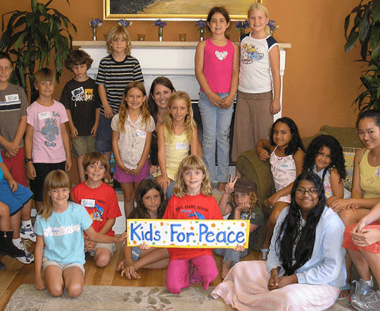
KIDS FOR PEACE PROGRAM
Notes:
Kids for peace is a program established in 2006 by two kids Jill and Danielle with the objective of providing children with peace through the use of art, social services, art and environmental services. The program also helps in management of health conditions affecting the kids.

Slide 2
HEALTH ISSUES
My program will focus on kids but especially with all kids who suffering from nervousness, because when they color and drawing they will have less stress and use all there energy on drawing and playing with other kids. Nervousness is a condition I kids affecting their proper interaction within their school and home setting. Painting allows them to remain focused and hence reducing the effects of the condition.
Notes:
In most learning environments, there are kids who are affected with nervousness which prevents their proper learning and mastery of the content taught as well as their interaction. Also, the condition affects their concentration making them exhibit a below average performance. However, through the kids for peace program, the affected kids are able to get proper attention improving their concentration hence their performance.

Slide 3
OBJECTIVES
• By the end of the program the percipients will be able to identify basic colors.
• By the end of the program the percipients will be helped reinforce concepts related to colors and all kids will be able to know attest one name of the color
Notes:
The program had well stated objectives that provide a proper assessment of the success of the program which include: by the end of the program the percipients will be able to identify basic colors. The other one being that by the end of the program the percipients will be helped reinforce concepts related to colors and all kids will be able to know attest one name of the color

Slide 4
TARGET AUDIENCE
The program targeted kids aged from 5 to 8 years
The program identified 10 boy and 10 girl affected with nervousness.
Notes:
The color program targeted kids below the age of ten years with focus on kids between the age of 5-8 years affected with nervousness. To ensure effectiveness, 10 boys and 10 girls were identified for the program.

Slide 5
PROGRAM DESCRIPTION
The program we will offer it to the kids age from 5 to 8 which is about color and fun which give times for kids to have fun and joy.
It will be a great time to spending time drawing and coloring with kids.
The program will provide the kids with an opportunity to interact through coloring .
Notes:
The kids for peace programs provides the kids with a range of opportunities fro them to improve their lives including art, social services, conscious leadership and global friendship. For this program, focus will be on the use of art through coloring to improve their concentration and interaction minimizing the effects of nervousness, allowing them to interact properly improving their performance.

Slide 6
MARKETING
Proper marketing of the program will ensure that the affected kids attend the program hence improving their interaction and academic performance. Social media provides a proper avenue through which the message reaches many people at the same time. Also, due to the improved technology and internet services, most people are able to access the available social media platform allowing for proper marketing.
Notes:
There are many kids affected by nervousness but do not get proper attention. However, through the kids for peace program, the affected kids are able to interact productively allowing them reduce the effects of the condition through coloring. Therefore, proper marketing of the event is critical ensuring the success of the program. For this program social media will be used to market the program since majority of the population access the available social media platforms ensruing quick and rapid spread of the information.

